Slide 1
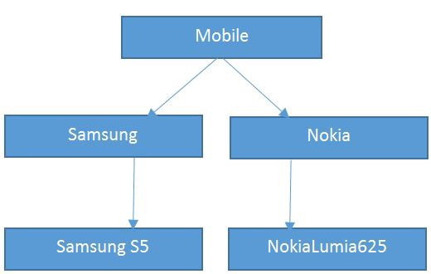
Inheritance in JAVA
Presentation by Rohit Aditya Sahoo

Slide 2
Overview of Inheritance in JAVA
A mechanism in which one object acquires all the properties and behaviors of a parent object.
Inheritance represents the IS-A relationship which is also known as a parent-child relationship.
Super Class: The class whose features are inherited is known as super class.
Sub Class: The class that inherits the other class is known as sub class.

Slide 3
Why Inheritance ?
Vehicle
Bike
Car
Truck
Allows us to carry the features
The aim of inheritance is to provide the reusability of code of the parent class to the subclasses.
A developer will create a class only to write the unique features and rest of the common properties and functionalities can be extended from the another class.
Code Reusability.

Slide 4
Syntax of Inheritance
class Subclass-name extends Superclass-name
{
//methods and fields
}
The meaning of "extends" is to increase the functionality.

Slide 5
Illustration of the concept
Bird
class Bird
{
public void nature() { System.out.println(”Birds fly"); }
}
class Bird extends Parrot
{
public void fauna() { System.out.println(“Parrots are Birds"); }
}
class Macaw extends Parrot
{
public void species() { System.out.println(“Macaw is a species of Parrot"); }
}
Parrot
Macaw
MULTILEVEL INHERITANCE

Slide 6
How it Works ?
Bird
nature()
Parrot
nature()
fauna()
Macaw
nature()
fauna()
species()

Slide 7
Facts about Inheritance
A subclass inherits all the members (fields, methods, and nested classes) from its super class. Constructors are not members, so they are not inherited by subclasses, but the constructor of the super class can be invoked from the subclass.
A subclass does not inherit the private members of its parent class.
The relationship between the two classes is Programmer IS-A Employee. It means that Programmer is a type of Employee.
Object
Laptop
Dell
Dell IS-A Object
Dell IS-A Laptop
Laptop IS-A Object

Slide 8
Use of Interfaces

